Slide 1
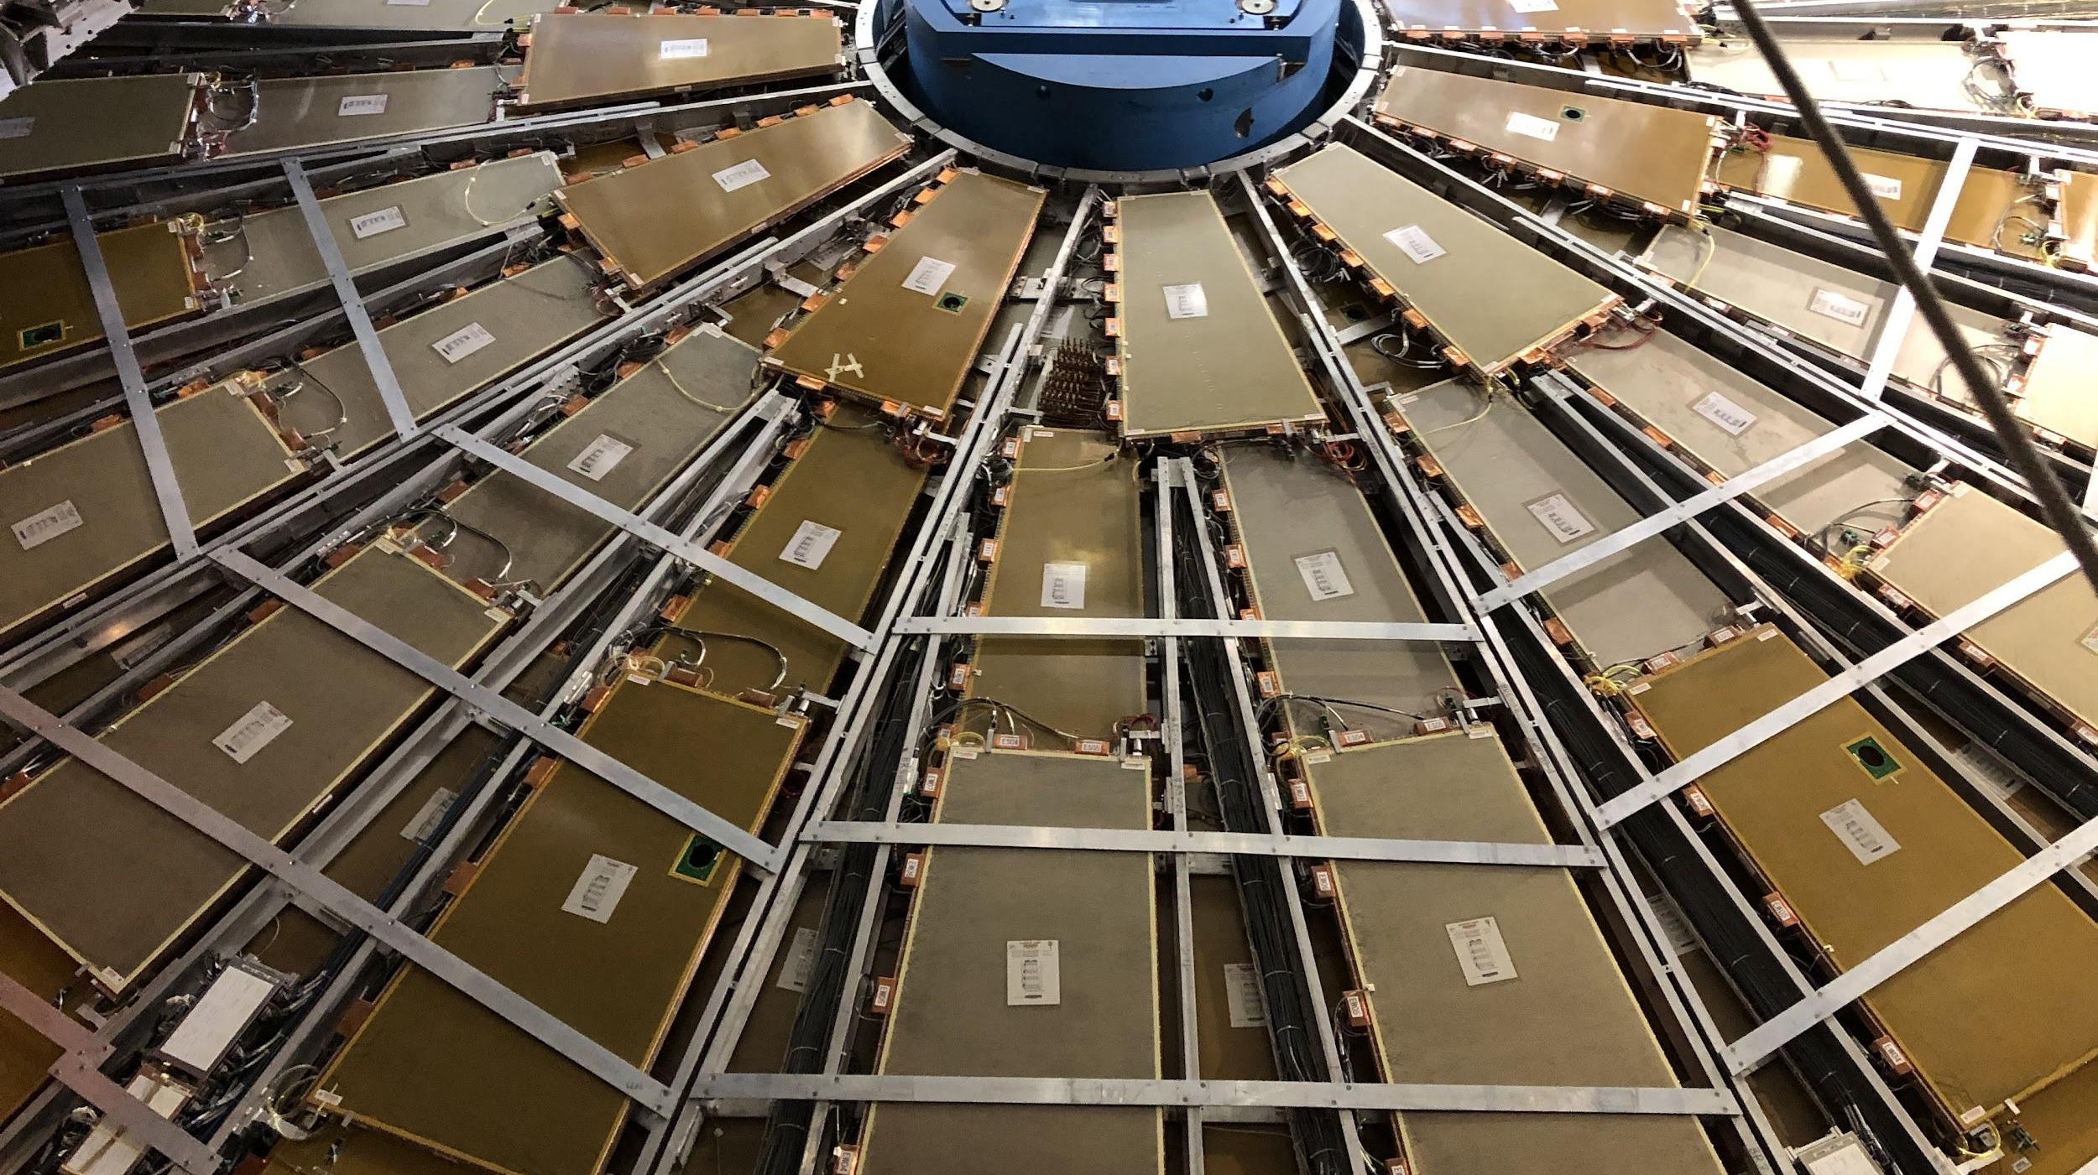


CIS Tech Update
Chicago Meeting, August 15th, 2022
Peter Camporeale and Jacky Li

Slide 2
Outline
CIS Constant Updates
June 23 - July 14
July 15 – August 9
Low Voltage Power Supply / Detector Control System Monitoring
L1 Trigger System
Fast Calo Simulation
Test Beam
ATLAS Control Room Shifts
Life

Slide 3
1.a. CIS Constant Update: June 23-July 14
Transition from last generation of Katie and Dawit to Peter and Jacky

Slide 4
1.b. CIS Constant Update: July 14 – August 8
Independently done by Peter and Jacky

Slide 5
2. LVPS/DCS Monitoring
Connected with Filipe Martins
Done:
Generated code for checking DCS values (Pending checking with Filipe)
To do:
Put the code into TIO
…
…

Slide 6
3. L1 Trigger System
Connected with Danijela Bogavac
Done:
Given overview of system and a tour in control room
To do:
Codes review?

Slide 7
4. Fast Calo Simulation (FCS)
Knowledge Transferred from Dawit
Done:
Recreated plots
To do:
None, until further notice.

Slide 8
5. Test Beam
Meeting with Irakli Minashvili
Done:
Checked the legacy Tile system in Test Beam.
To do:
Shift training.
None, until further notice. (Irakli is taking his vacation)

Slide 9
6. ATLAS Control Room Shifts
Peter’s first shifts were August 2 – August 8
Monitoring data quality for Tile modules
Reporting on LAr status and major problems
More shifts in late August and September
Jacky’s shift training is in late August, will take shifts next semester

Slide 10
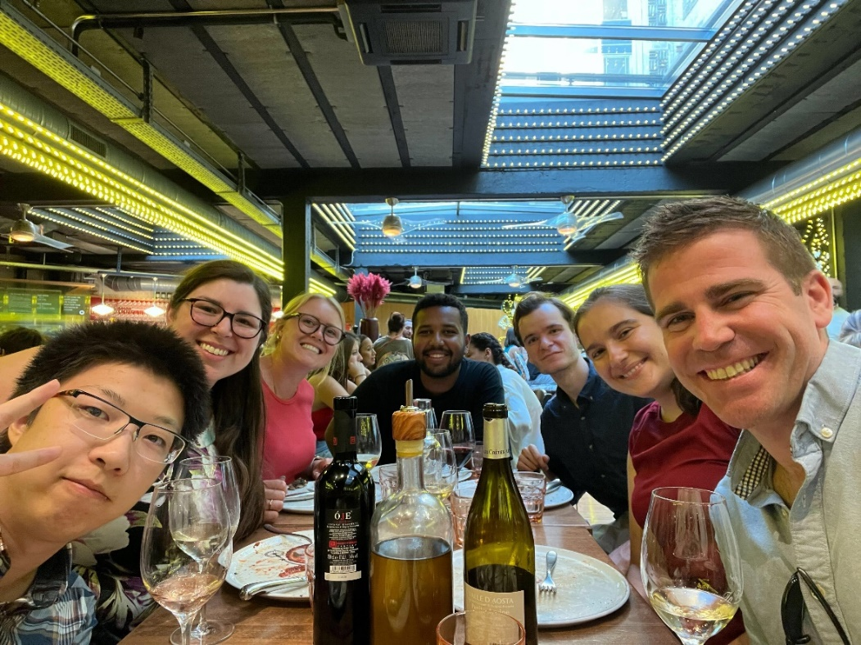
7. Life
Old CIS techs leaving
Katie left on July 25
Dawit left on August 13
Prof. David Miller’s visit late June
Getting settled in the city
Learning/refreshing driving manual
June 29th , Dinner at Luigi’s

Slide 11
7. Life (More Pictures)
Jacky teaching Peter to drive manual
June 29th , Dinner at Luigi’s

Slide 12
8. Questions
Peter’s first shifts were August 2 – August 8
Monitoring data quality for Tile modules
Reporting on LAr status and major problems
More shifts in late August and September
Jacky’s shift training is in late August, will take shifts next semester

Slide 13
Thank you for your attention ☺

